Slide 1

A preliminary approach to the acoustic-perceptual characterization of dysarthria
Eugenia San Segundo
Dept. Spanish Language & General Linguistics, UNED, Madrid, Spain
Jonathan Delgado
Dept. Developmental and Educational Psychology, La Laguna University, Tenerife, Spain

Slide 2
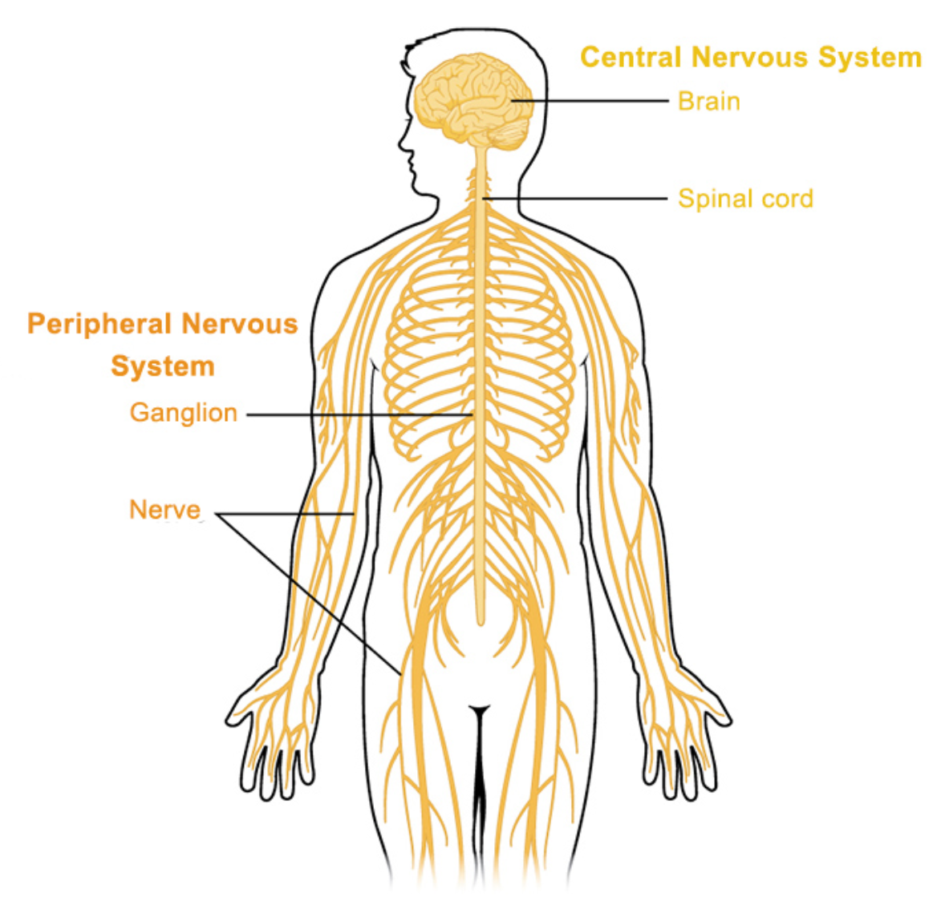
1. Introduction
What is dysarthria
Speech disorder derived from a neurological damage of the
central nervous system (CNS) or peripheral nervous system (PNS)
Difficulties in motor programming or execution
Alterations in muscles→ strength, tone, speed and precision of the movements
Which muscles are affected? Those involved in speech production:
breathing
phonation
articulation
resonance
Image credit: OpenStax Anatomy and Physiology / Wikimedia

Slide 3
1. Introduction
Previous studies
Focus on dysarthric individuals of specific neurodegenerative disorders (Parkinson’s disease, PD)
Pinto et al. (2017)
Kreiman & Gerratt (2020)
Moro-Velázquez et al. (2021)
Frequently investigated acoustic features in dysarthria:
spectral and cepstral measures
measures of F0 variability
frequency and amplitude variation from cycle to cycle
features covering loudness, voicing, articulation and also temporal measures (speech rate, syllable rate, syllable duration, number and length of pauses) [Metter & Hanson 1986; Delgado 2017]
Less is known about the perceptual characterization of dysarthria
even though auditory assessment in clinical studies is still regarded as the gold standard with which acoustic measures are compared [Ma & Yu 2005]
Aim of this investigation
To characterize dysarthria by exploring
a large number of acoustic predictors
different perceptual features related to voice quality (VQ), understood in a broad sense as comprising both laryngeal and supralaryngeal long term configurations, or settings.
To evaluate dysarthric patients in general (not only PD patients) + a control population of neurologically healthy speakers
analyzing their speech production acoustically and perceptually
Vocal Profile Analysis (VPA)
First time in dysarthric subjects?
Better known protocol among forensic phoneticians
Yet, used before to characterize Down syndrome speakers [Beck 1997]

Slide 4

2. Method
Participants
30 native speakers of Spanish:
15 neurologically healthy (mean age 41.86, SD 13.62)
15 dysarthric (mean age 42.93, SD 10.31)
10 ataxic dysarthria
2 spastic dysarthria
3 mixed dysarthria
Example of dysarthric female speaker
Spastic → associated with bilateral disorders of the upper motor neuron system
Ataxic → associated with disorders of the cerebellar control circuit
Mixed → various combinations of dysarthria types (e.g., spastic-ataxic) [Duffy 2013]

Slide 5
2. Method
Recording setup
Soundproof booth
AKG C544L head-mounted condenser microphone
Sampling rate of 44.1 kHz and 16 bits of resolution
Sound card Alesis io2 express
PC with Praat
Signal-to-noise ratio (SNR) measured post hoc to check the level of environmental noise of the voice recordings.
All samples were consistent with the recommended threshold proposed by [Deliyski, Shaw & Evans 2005] (SNR>30dB).
Speech samples
Reading task: 4 phonetically balanced sentences of the Spanish Matrix Sentences Test [Hochmuth et al. 2012]
Duration: around 20s.
Carmen tiene dos libros grandes
Elena compra doce platos nuevos
Teresa hace siete regalos pequeños
Josefa vende tres zapatos azules

Slide 6
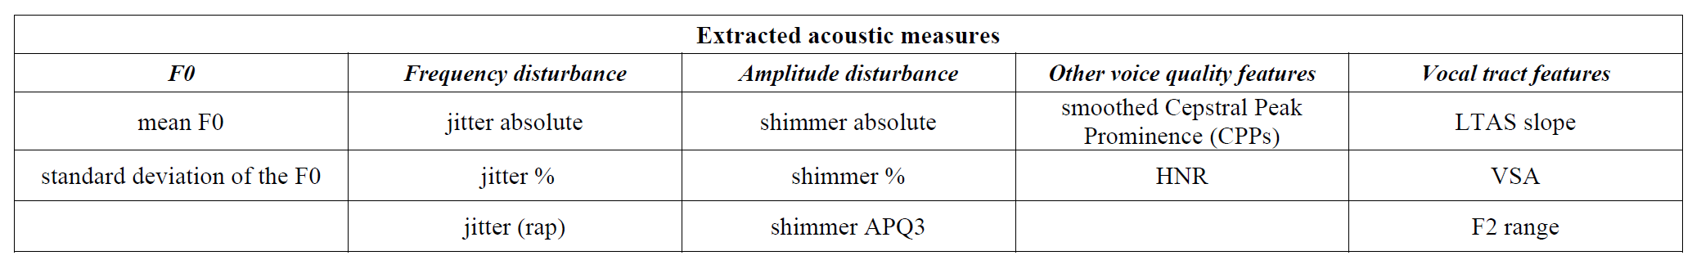
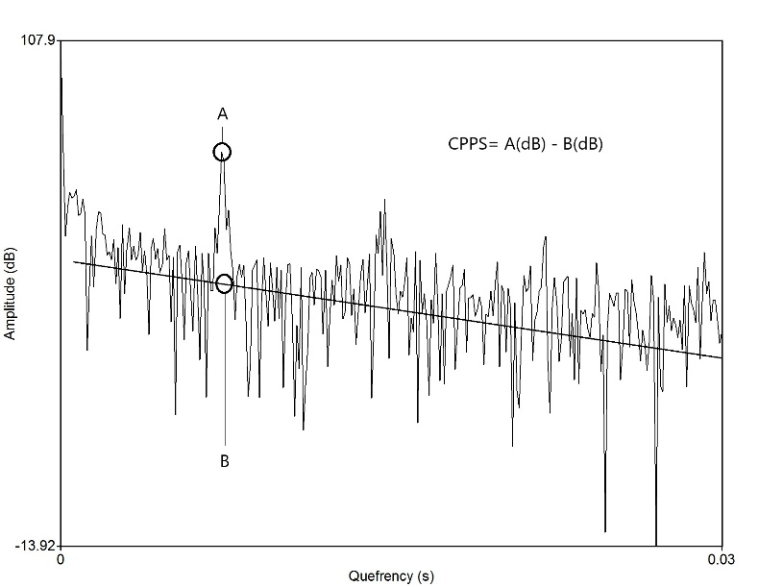
2. Method
Acoustic analysis
All the acoustic measures (13) were extracted with Praat.
Acoustic Voice Quality Index 03.01
[Barsties & Maryn 2016]
Temporal acoustic analyses were conducted only on voiced segments of continuous speech through an automated detection Praat script [Maryn et al. 2010].
CPPs = difference between the most prominent cepstral peak (first rahmonic) and the point with the same quefrency on the line of regression through the smoothed cepstrum

Slide 7
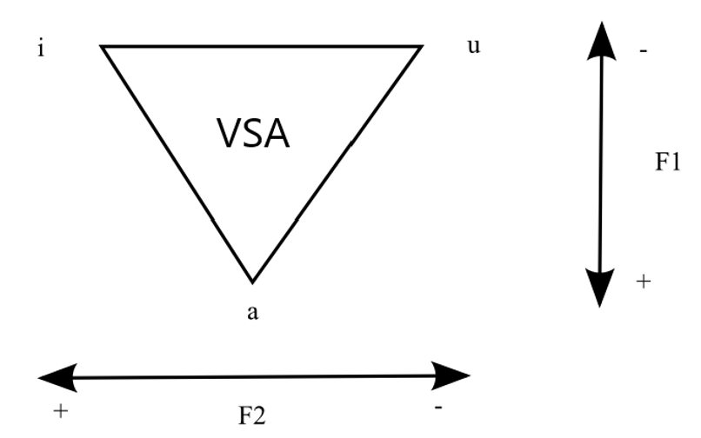
2. Method
Acoustic analysis
All the acoustic measures were extracted with Praat.
{[F1i × (F2a – F2u) + F1a × (F2u – F2i) + F1u × (F2i – F2a)]/2}
Vowel Space Area: equation outlined by [Sapir et al. 2010]
F1 and F2 of stressed /i/, /a/ and /u/ in “libros”, “Carmen” & “azules”
F2 range: max F2 – min F2 in diphthong [je] of the word “tiene”

Slide 8
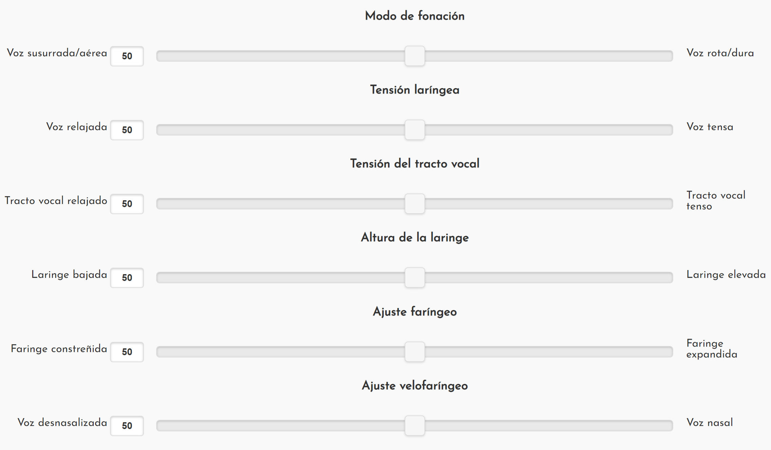
2. Method
Perceptual analysis
Simplified Vocal Profile Analysis (SVPA) [San Segundo & Skarnitzl 2021]
Visual Analogue Scale (VAS)
Computer-based interface
Based on VPA scheme [Laver 1980]
Each of the organs of the vocal apparatus contributes to the VQ of a speaker.
Laryngeal + supralaryngeal long term configurations
SVPA: following 10 settings
Free tool available at: https://eugeniasansegundo.github.io/vas/es.html
voice type laryngeal tension vocal tract tension laryngeal height pharyngeal | velopharyngeal dorsal apical mandibular labial setting

Slide 9
2. Method
Perceptual analysis
Two raters:
Phonetician
Speech language pathologist
36 speech samples
30 participants
6 repeated voices
Blind rating
Same order
Short break every 12 stimuli
No previous experience using this protocol with pathological voices

Slide 10
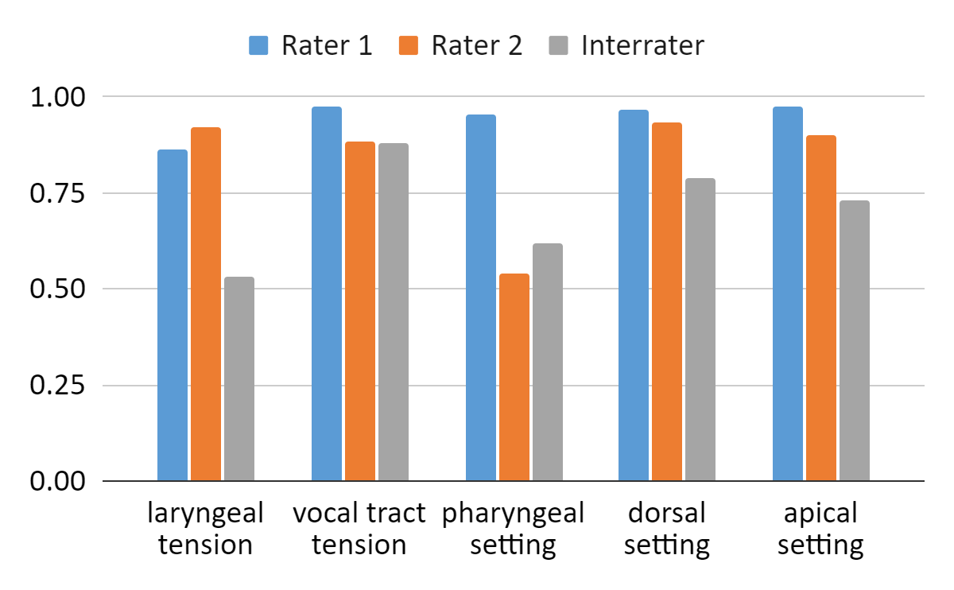
3. Results
Intra- and interrater agreement
Intraclass correlations coefficients (ICCs) were calculated to determine intra- and inter-rater reliability.
In both cases, a two-way, consistency, single-measure model (ICC (2,1)) was used.
Guidelines for interpretation [Cicchetti 1994]
Less than 0.40—poor
Between 0.40 and 0.59—fair
Between 0.60 and 0.74—good
Between 0.75 and 1.00—excellent

Slide 11
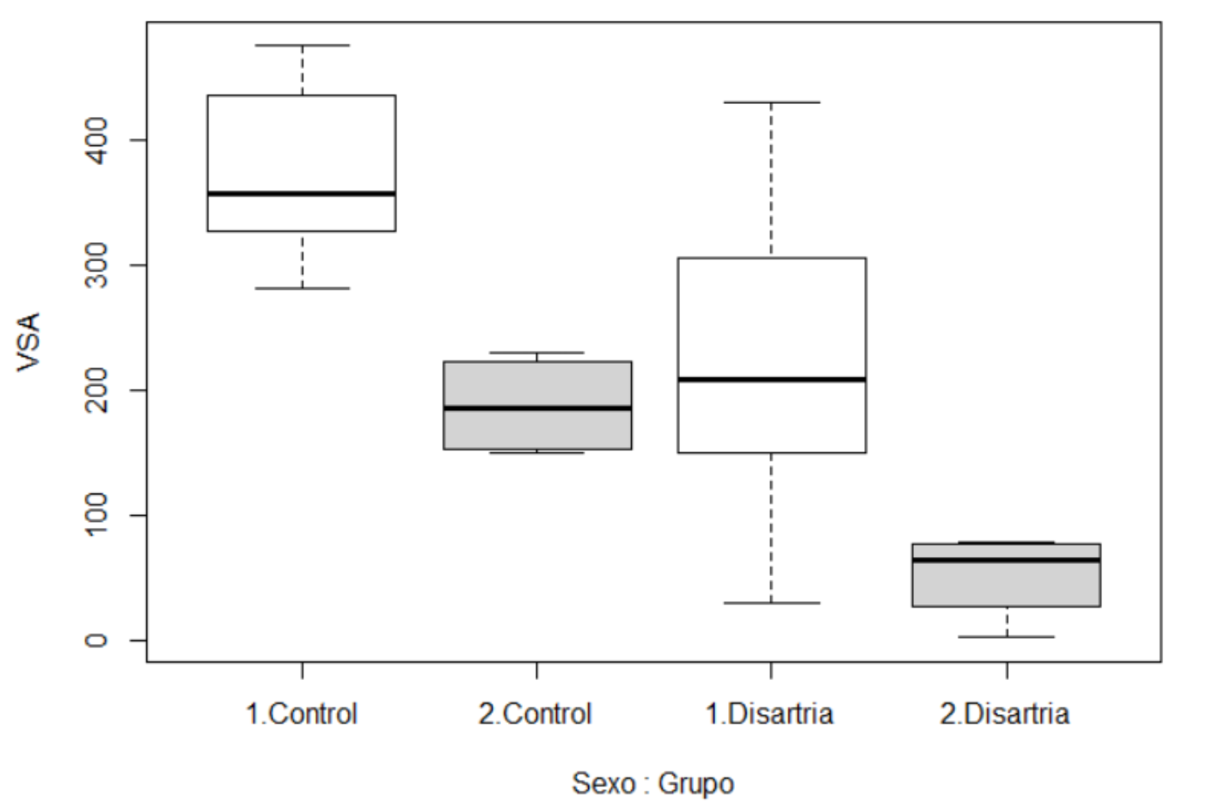
3. Results
Linear models
Statistical modelling → linear model function of R
lm(formula = laryngeal_tension ~ CPPs + LTASslope + VSA + F2range + F0 + JitterPerCent + ShimmerPerCent + HNR + Group + Sex, data = all_data_mean)
Goal → to test for interaction between VPA perceptual ratings, per setting (dependent variable) and a number of predictors (fixed effects)
Predictor 1. Group (whether dysarthria or control)
Predictor 2. Sex (male / female)
Predictor 3-14: all the acoustic predictors
Why sex is not considered a random effect? →
grey = female
white = male

Slide 12
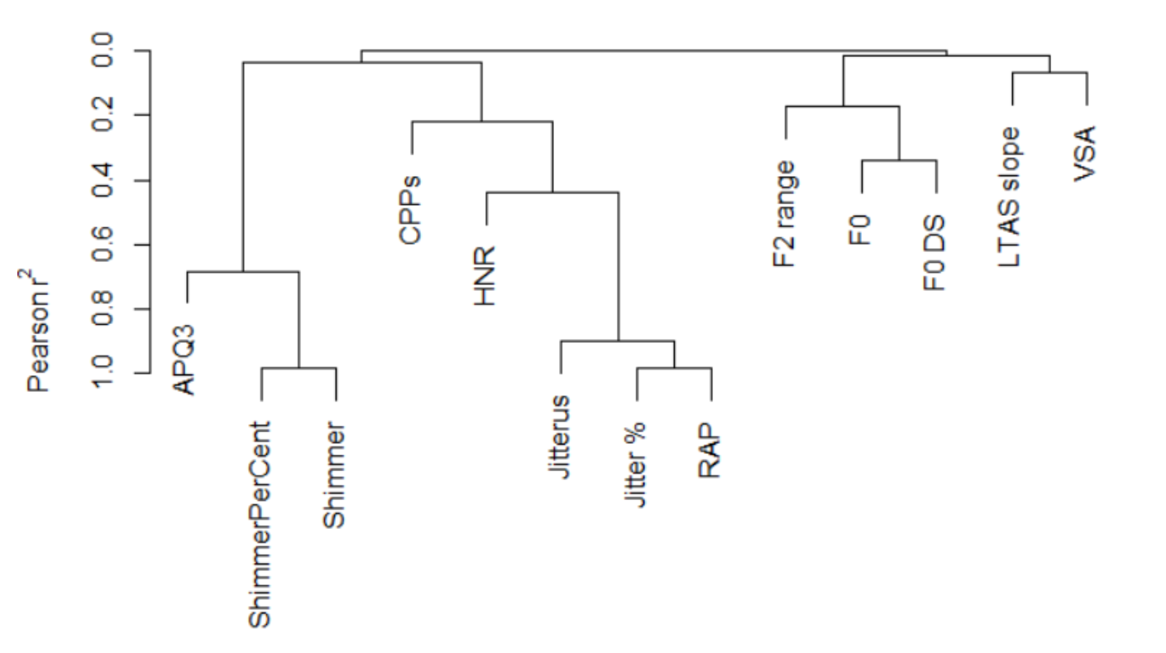
3. Results
Linear models
Why are there only 8 acoustic predictors in the models?
Collinearity test between independent variables revealed that
some of these had to be discarded.
This reduces the potential number of predictors
down to a small number of non-correlated dimensions.

Slide 13
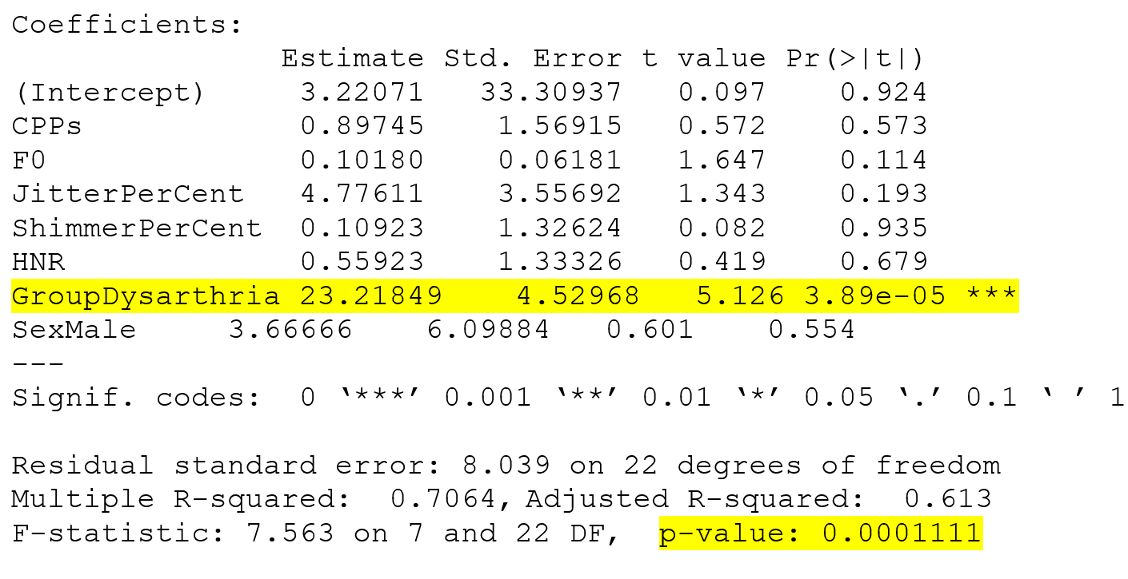
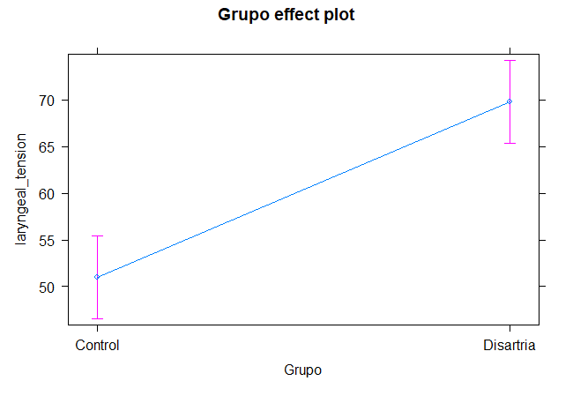
3. Results
Linear models
All the linear models were significant → the perceptual ratings given to the 5 VPA settings can be explained by a model covering all those predictors.
For most VPA settings, the best models fitted to the data were simpler models (based on model comparison).
Laryngeal tension

Slide 14
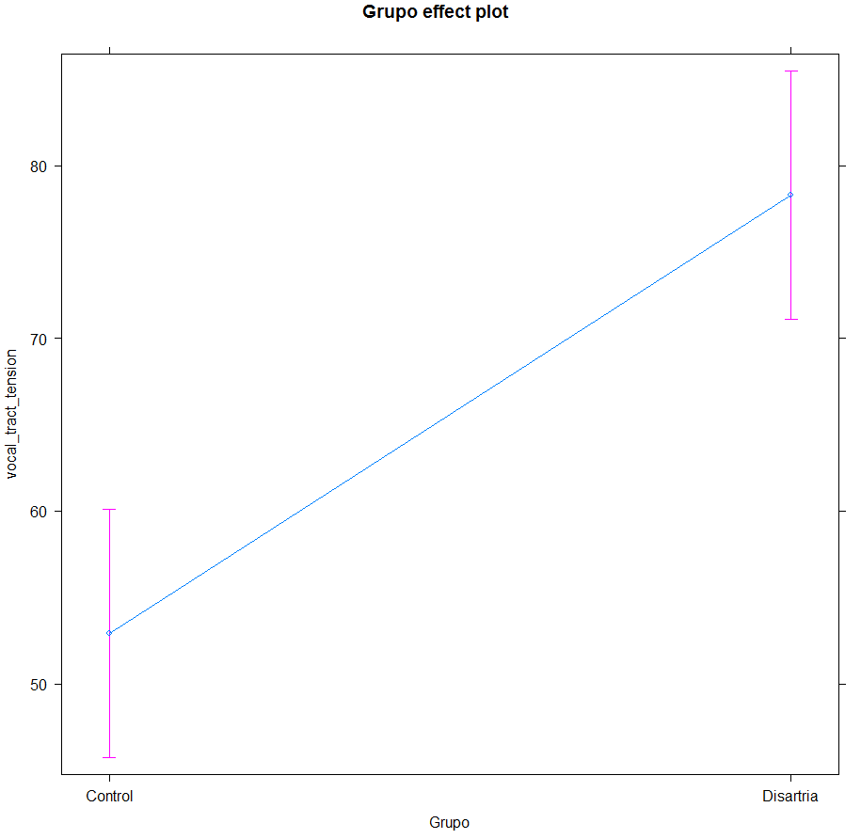
3. Results
Vocal tract tension
Linear models
Voices perceived and rated as “tense”
Voices perceived and rated as “laxer” / “neutral”

Slide 15
3. Results
Linear models
VPA setting | Predictors | Model Significance
Laryngeal tension | CPPs + F0 + Jitter% + Shimmer% + HNR + Group*** + Sex | (F(7,22)= 7.6, p<0.001 ***
Vocal tract tension | LTAS slope + VSA + F2 range + F0 + Group*** + Sex | (F(6,23)= 22.4, p<0.001 ***
Pharyngeal setting | CPPs* + LTAS slope + VSA + F2 range + Group + Sex | (F(6,23)= 22.4, p<0.05 *
Dorsal setting | CPPs* + LTAS slope + VSA + F2 range + Group + Sex | (F(6,23)= 9.5, p<0.001 ***
Apical setting | CPPs + LTAS slope + VSA + F2 range + Group + Sex | (F(6,23)= 7.1, p<0.001 ***

Slide 16
4. Discussion
Intra- and interrater agreement is considerably good to allow for robust analyses (linear models) with averaged ratings
Most linear models are significant using only 4-5 acoustic parameters → simpler models preferred over more complicated ones
Acoustic parameters in each model depend on the VPA setting
Laryngeal tension: CPPs + F0 + Jitter% + Shimmer% + HNR + Group*** + Sex
Vocal tract tension: LTAS slope + VSA + F2 range + F0 + Group*** + Sex
Pharyngeal setting: CPPs* + LTAS slope + VSA + F2 range + Group + Sex
Dorsal setting: CPPs* + LTAS slope + VSA + F2 range + Group + Sex
Apical setting: CPPs + LTAS slope + VSA + F2 range + Group + Sex
Relevance of CPPs → is dysarthria a new clinical field where CPP has great potential for characterizing pathological speakers?
Previous studies had shown its potential for determining VQ in pathological voices:
for overall dysphonia [in 2018 the American Speech-Language-Hearing Association (ASHA) recommended CPP as “a general measure of dysphonia”]
as a cue to detect specific voice disorders, such as neurogenic voice disorders, laryngeal disorders, vocal fold nodules, etc.
and even some researchers have proposed its application to other purposes such as the assessment of speech intelligibility, the detection of cognitive load, or even the evaluation of the sexual appeal of a voice. [apud Fraile & Godino-Llorente 2014].

Slide 17
5. Conclusions and future work
Conclusions
Specific:
It seems that VPA settings related to tension are key to characterize dysarthria perceptually
- VOCAL TRACT TENSION:
dysarthric voices perceived as more tense
- LARYNGEAL TENSION:
dysarthric voices perceived as more tense
+ other VPA settings (related to the pharynx and the tongue: tip and blade)
This makes sense since dysarthria is a motor speech disorder in which the muscles used to produce speech are damaged, paralyzed, or weakened → compensated with overexertion or overstraining
General:
VPA protocol allows for clinical applications besides its most common use in sociolinguistic and forensic studies
Implications for clinical practice
Acoustic-perceptual assessment through VPA is an important complement to traditional assessment in dysarthria
It provides relevant information on the functioning of the supraglottic structures commonly affected in this type of motor speech disorders
The information obtained makes it possible to assess the evolution of dysarthria and to establish therapeutic objectives
Future work
Add at least one more rater
Measure intelligibility of dysarthric speakers
Prosodic, rhythmic measures (e.g. articulation rate)
More patients →propose a VPA-based tool specific for dysarthria

Slide 18
Thank you very much for your attention!
esansegundo@flog.uned.es

Slide 19
References
B. Barsties, Y. Maryn, “External validation of the Acoustic Voice Quality Index Version 03.01 with extended representativity,” Ann Otol Rhinol Laryngol. 2016;125, pp. 571-583.
J.M. Beck, “Organic variation of the vocal apparatus”. In Gibbon, F., Hardcastle, W. J., & Laver, J (Eds), The handbook of phonetic sciences, pp. 256-297. Wiley. 1997.
D. Cicchetti, “Guidelines, Criteria, and Rules of Thumb for Evaluating Normed and Standardized Assessment Instruments in Psychology”. Psychological Assessment. 1994; 6, pp. 284-290.
J. Delgado-Hernández, “Estudio piloto sobre los valores acústicos de las vocales en español como indicadores de la gravedad de la disartria,” Rev Neurol 2017; 64: 105-11.
D.D. Deliyski, H.S. Shaw, M.K. Evans, “Adverse effects of environmental noise on acoustic voice quality measurements,” J Voice, 2005; 19, pp. 15-28.
J.R. Duffy, ”Motor speech disorders: Substrates, differential diagnosis, and management”. St. Louis, MO: Elsevier. 2013.
R. Fraile, J.I. Godino-Llorente, “Cepstral peak prominence: A comprehensive analysis”, Biomedical Signal Processing and Control, 2014; 14, pp. 42-54.
S. Hochmuth, T. Brand, M.A. Zokoll, F. Zenker, N. Wardenga, B. Kollmeier B, “A Spanish matrix sentence test for assessing speech reception thresholds in noise,” Int J Audiol, 2012; 51, pp. 536-544.

Slide 20
References
J. Kreiman, B. R. Gerratt. "Acoustic Analysis and Voice Quality in Parkinson Disease." In Automatic Assessment of Parkinsonian Speech Workshop, pp. 1-23. Springer, Cham, 2019.
J. Laver, The phonetic description of voice quality. London: Cambridge Studies in Linguistics London, 1980.
E.P.M. Ma, E.M.L. Yu, “Multiparametric evaluation of dysphonic severity,” J. Voice. 2005; 20, pp. 380–390.
Y. Maryn, P. Corthals, P. Van Cauwenberge, N. Roy, M. De Bodt, “Toward improved ecological validity in the acoustic measurement of overall voice quality: combining continuous speech and sustained vowels,” J Voice, 2010; 24, pp. 540-555.
E.J. Metter, W.R. Hanson, “Clinical and acoustical variability in hypokinetic dysarthria,” Journal of communication disorders, 1986, 19(5), 347-366.
L. Moro-Velazquez, J.A. Gomez-Garcia, J.D. Arias-Londoño, N. Dehak, J.I. Godino-Llorente, (2021). “Advances in Parkinson's Disease detection and assessment using voice and speech: A review of the articulatory and phonatory aspects”, Biomedical Signal Processing and Control, 2021, 66.
S. Pinto, A. Chan, I. Guimarães, R. Rothe-Neves, J. Sadat, J. “A cross-linguistic perspective to the study of dysarthria in Parkinson’s disease”, Journal of Phonetics, 2017; 64, pp. 156-167.
E. San Segundo, R. Skarnitzl, “A computer-based tool for the assessment of voice quality through visual analogue scales: VAS-Simplified Vocal Profile Analysis,” J Voice, 2021; 35 (3), pp. 497.e9-497.e21.
S. Sapir, L. Ramig, J. Spielman, C. Fox, “Formant centralization ratio (FCR) as an acoustic index of dysarthric vowel articulation: comparison with vowel space area in Parkinson disease and healthy aging”, J Speech Lang Hear Res 2010; 53: 114-25.

